Slide 1

Determining Heart Disease Mortality Factors
By: Nathan Kuneman

Slide 2

Background
Heart disease mortality rates vary significantly across different counties and states within the United States.
What is causing these differences?
Data from government health data, the US Census Bureau, and NOAA.
Notes:
National Oceanic and Atmospheric Administration

Slide 3
The Data
Government Health Data
Age-adjusted heart disease mortalities per 100k residents
County information
Key Features
U.S. Census Data
Important notes:
Heart disease statistics are age-adjusted and per 100k residents
U.S. Census data for household incomes is only an estimate
Once the data was merged there were 3,104 rows of data per year that contained no NaN values
Looked at years 2013-2018
Mean household income
County information
NOAA Data
Average temperature per year
County information

Slide 4
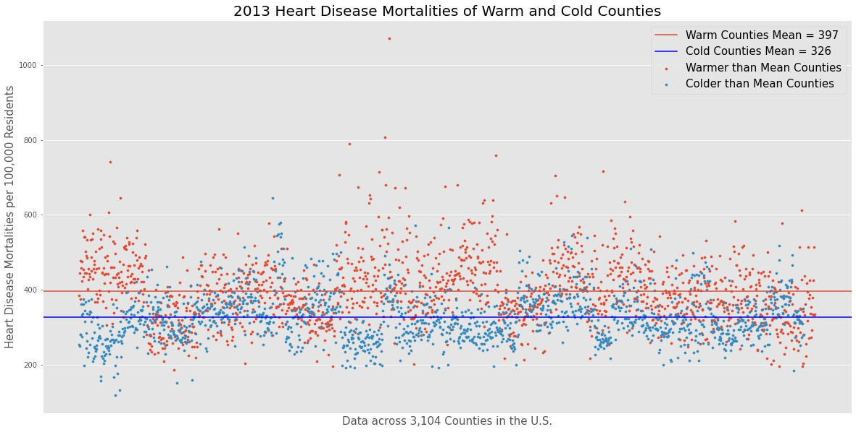
Exploratory Data Analysis: Temperature
How:
Divided the counties into two buckets based on if they fell above the mean temperature across all counties.
Main findings:
Warmer counties tend to have a larger range in their distribution.
The mean of warmer counties is higher than that of colder counties.
Mortality rates follow a normal distribution with the exception of one outlier.

Slide 5
Franklin Parish, Louisiana
The only data point that fell outside of the distributions of the two groups was Franklin Parish, Louisiana. With a heart disease mortality rate of 1071.6 per 100,000 residents, it was more than twice the mean and 265.2 higher than the next highest county.
Because this point is caused by a distribution outside of the one I am looking at, I have chosen to ignore this data point during hypothesis testing.

Slide 6
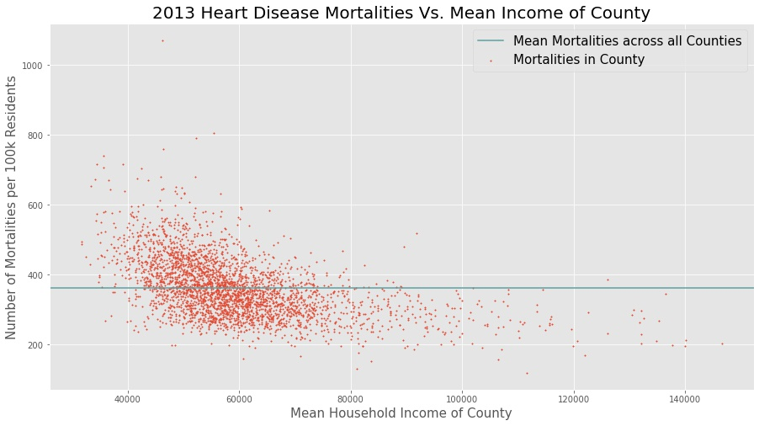
Exploratory Data Analysis: Income
How:
I looked at heart disease mortality rates as the mean household income for the county increased.
Main findings:
There is clearly a downward trend of mortalities as income increases.
Counties at the extremes seem to be the most affected by the trend

Slide 7
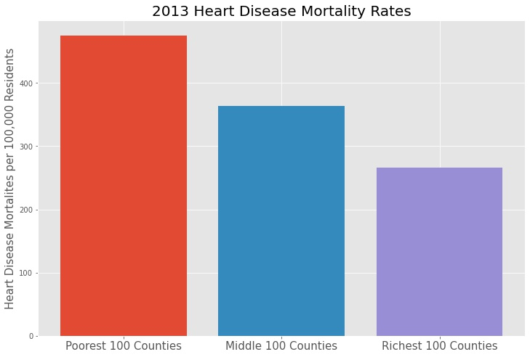

Slide 8
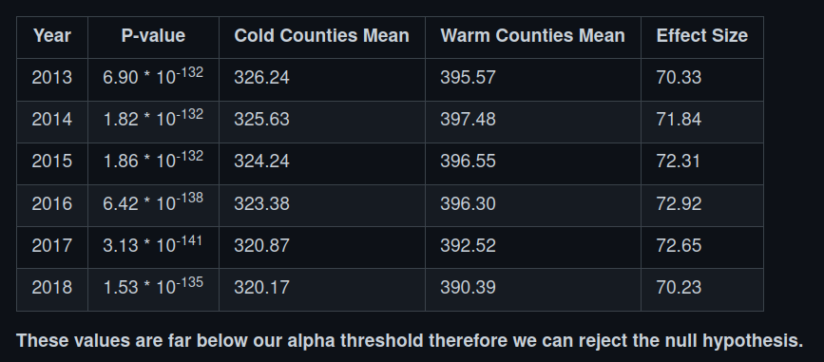
Hypothesis Testing: Temperature
Null hypothesis: Mean of cold counties = Mean of warm counties
Alternate hypothesis: Mean of cold counties != Mean of warm counties
Alpha value = .00833

Slide 9
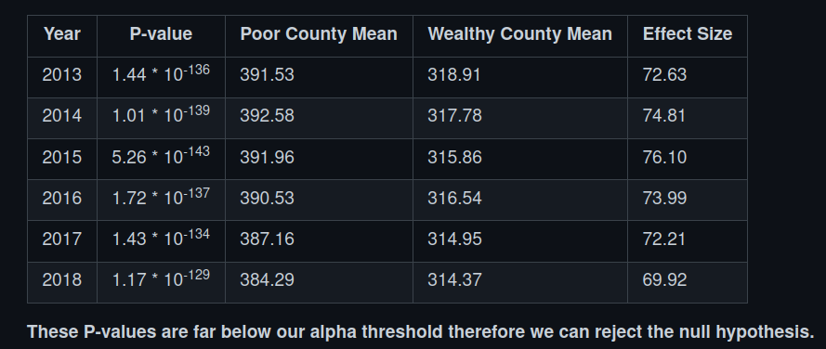
Hypothesis Testing: Income
Null hypothesis: Mean of poor counties = Mean of wealthy counties
Alternate hypothesis: Mean of poor counties != Mean of wealthy counties
Alpha value = .00833

Slide 10
Conclusions:
Temperature is a statistically significant feature when it comes to heart disease mortality rates
Mean household income is a statistically significant feature when it comes to heart disease mortality rates
Usefulness:
Informing policy-makers in high risk counties so they can better protect their constituents
Lead to further exploration as to why these features are statistically significant
Informing residents of high risk counties so they can make better health decisions

Slide 11
Questions
Contact info:
Nathan Kuneman
www.GitHub.com/NathanKuneman
207-479-1989
Nathan.Kuneman@yahoo.com

